Slide 1
Large Language Models
Ryan Daniels
Senior Machine Learning Engineer
Accelerate Programme for Scientific Discovery

Slide 2
What does AI mean to you?
Notes:
Audience will engage in a slido poll

Slide 3

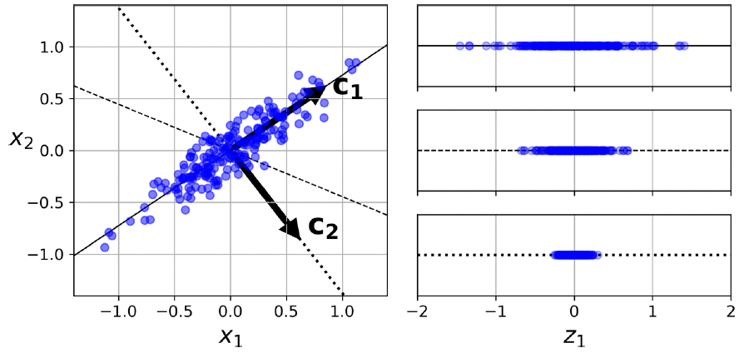
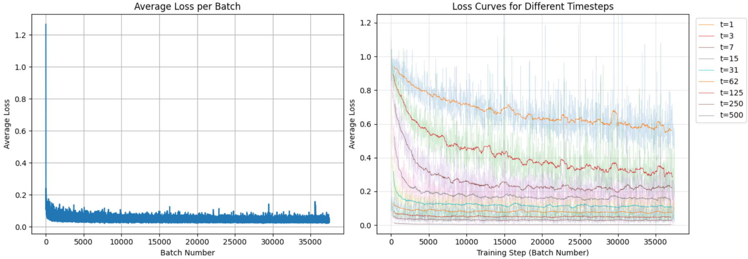
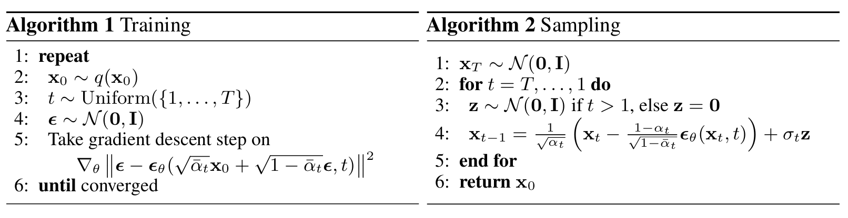
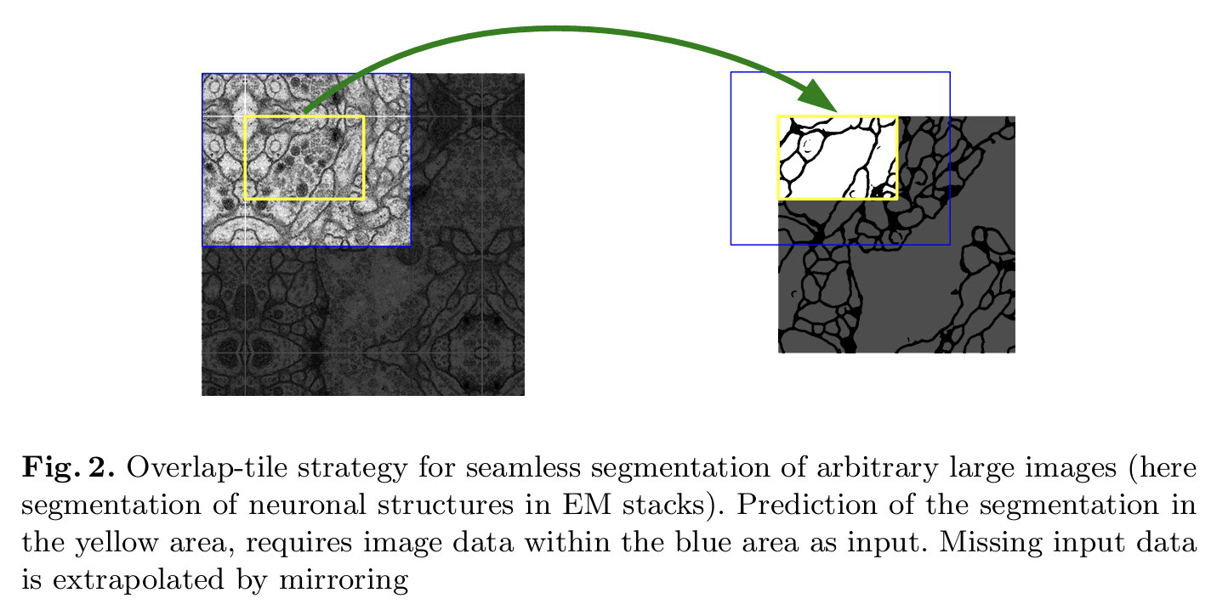
What AI means to me
Notes:
Lots of people, and companies want us to think that nobody can do what they can do.
This was actually expressed by Sam Altman a while ago, when he basically said that smaller groups simply cannot compete with OpenAI when it comes to training foundation models.
Part of this is also expressed in the nature of the papers that are published - they are all steeped in this mathematical language; they seem inaccessible to people who are not mathematicians and computer scientists; we don’t have access to millions of dollars of computational resources.
So instead, they just say to us, don’t worry about it.
And I think I disagree with this sentiment. And hopefully after this, so will you

Slide 4
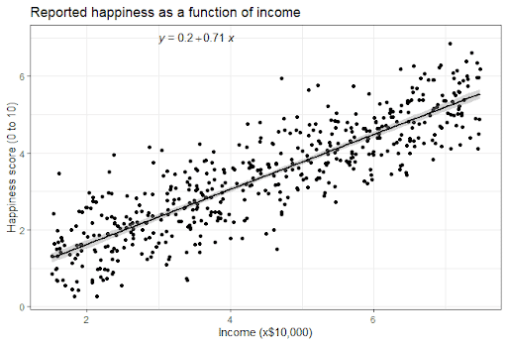
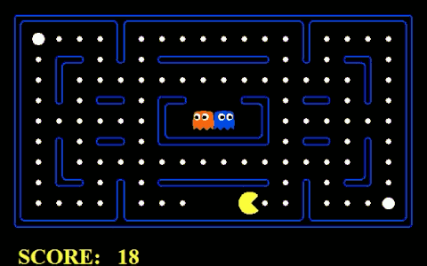
What AI means to me
Rule-based
Data-based
Notes:
Two ways of thinking about AI

Slide 5
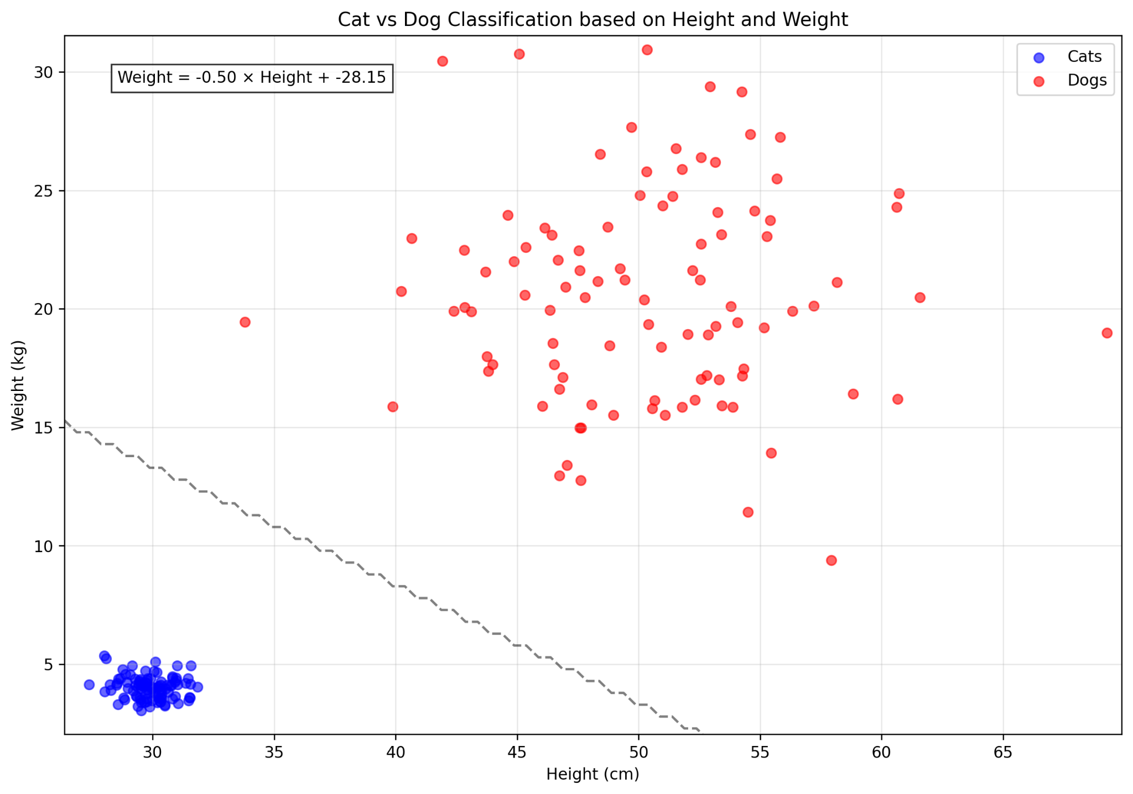
What AI means to me
Notes:
AI is essentially: learn this line.

Slide 6
The Hardware
Or: why AI is super expensive

Slide 7
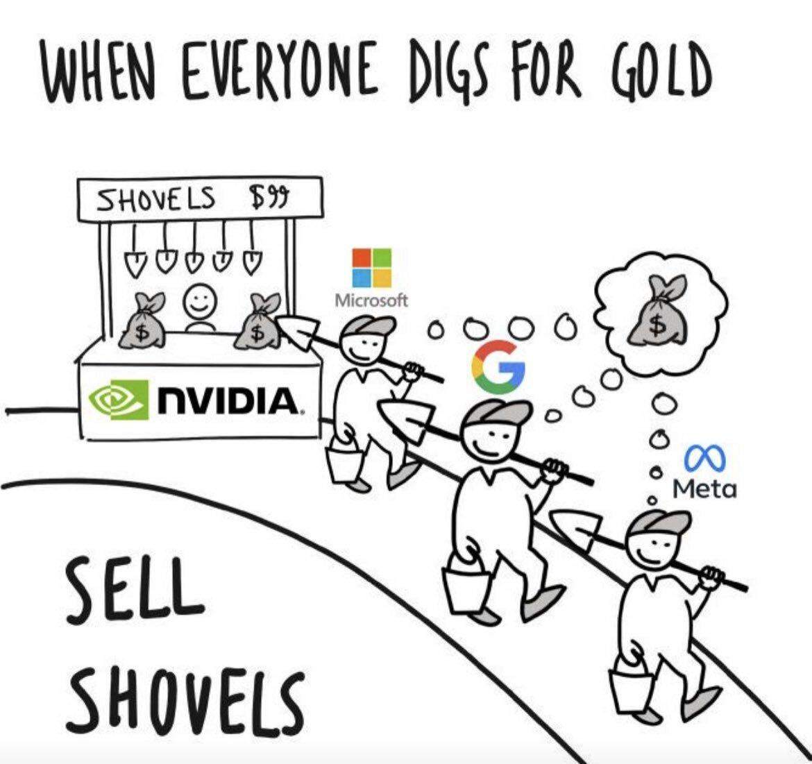
Notes:
Probably the first step is to talk about the hardware, the computational substance, that makes AI possible.

Slide 8
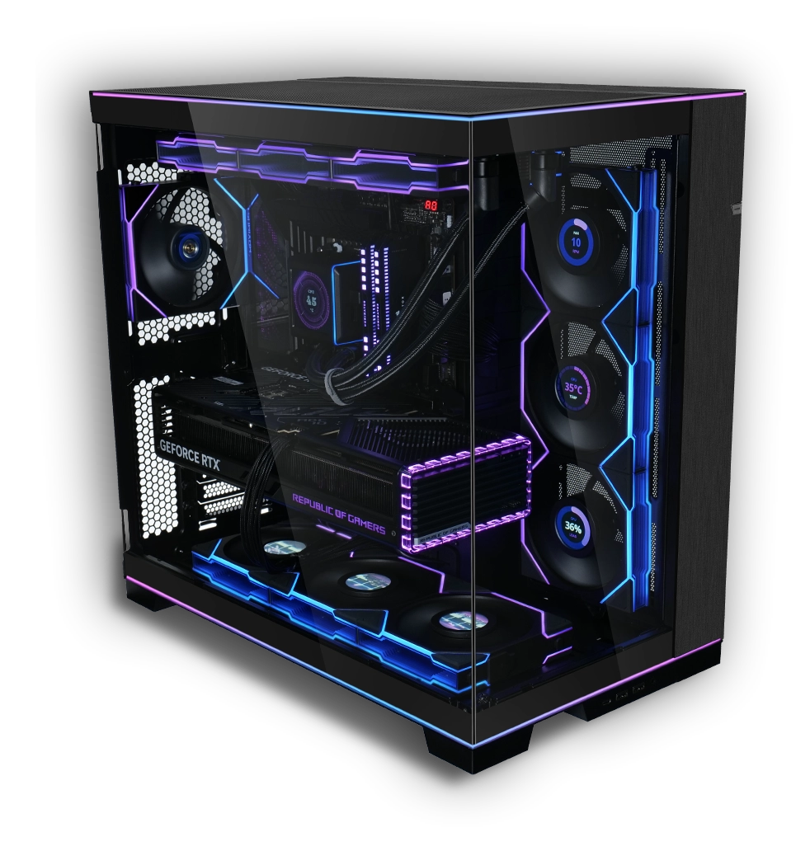
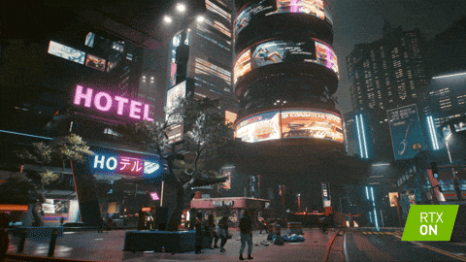
GPUs
Notes:
We know computers as great for running video games (or at least that’s what I use them for).
But it turns out that what makes computers great at running games, is also what makes them great at being AI.

Slide 9

Notes:
This is a GPU (graphics processing unit). It’s responsible for rendering images and videos like the one we saw on the previous slide.

Slide 10
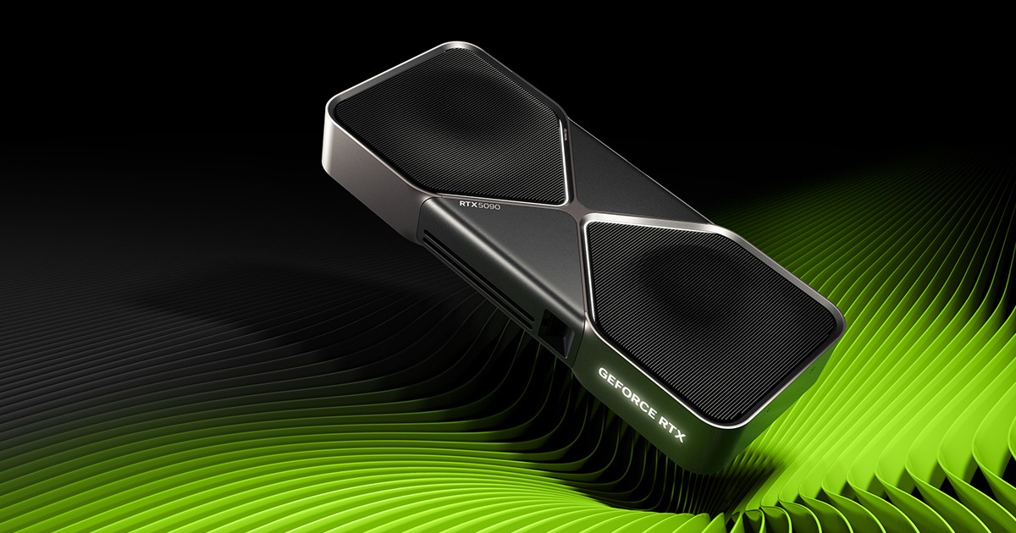
Notes:
This is a commercial one that you put in a machine at home. This will set you back around £2,500.

Slide 11
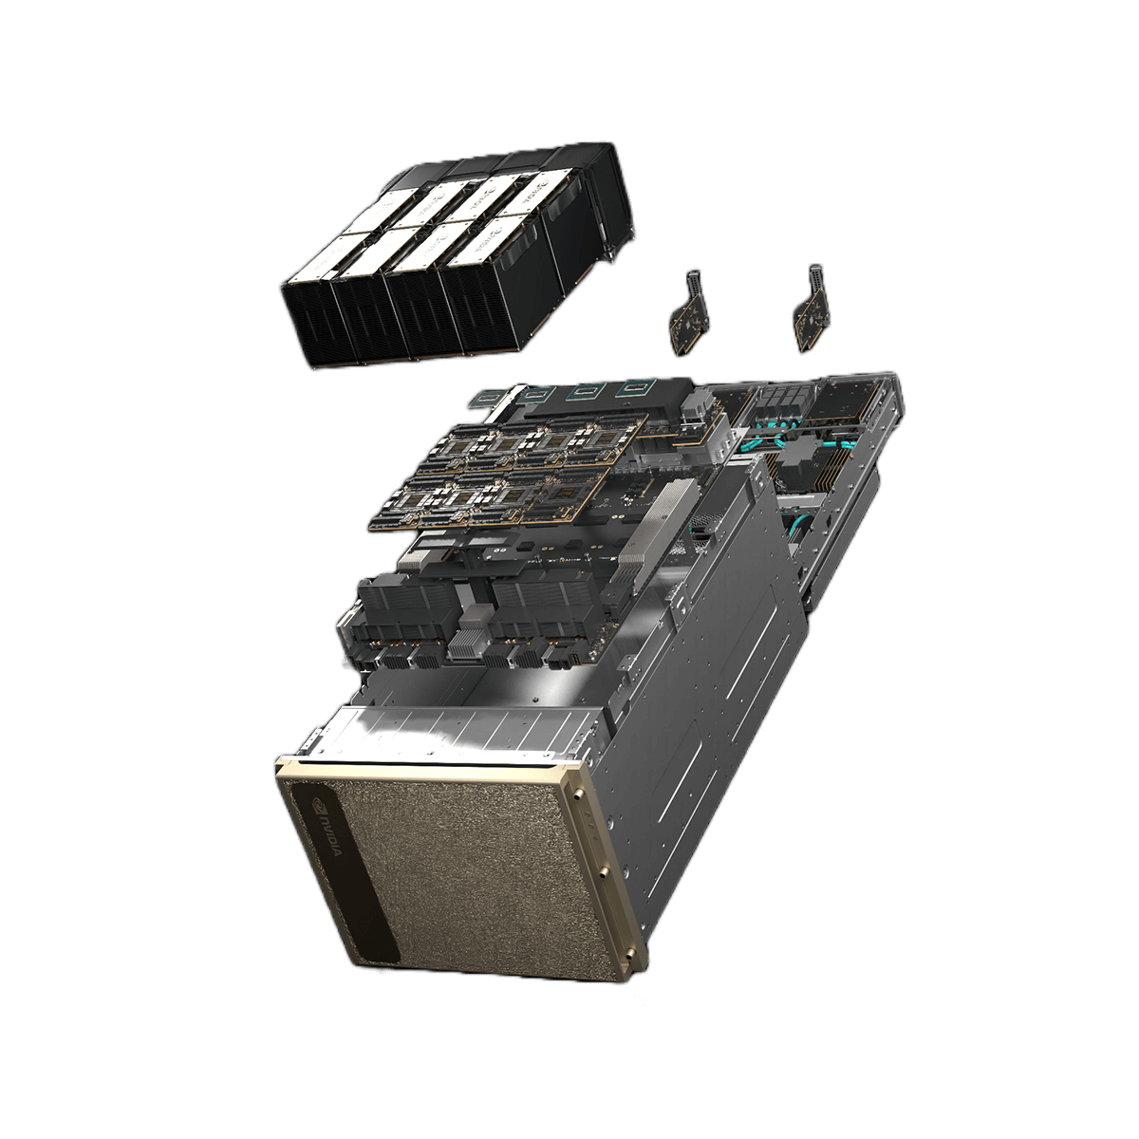

GPUs
Notes:
This is a data center unit, and it’ll cost around half a million pounds.
xAI bought 12,000 of these
There are competitors to Nvidia, but the reality is that Nvidia has a stranglehold on the compute market today.

Slide 12
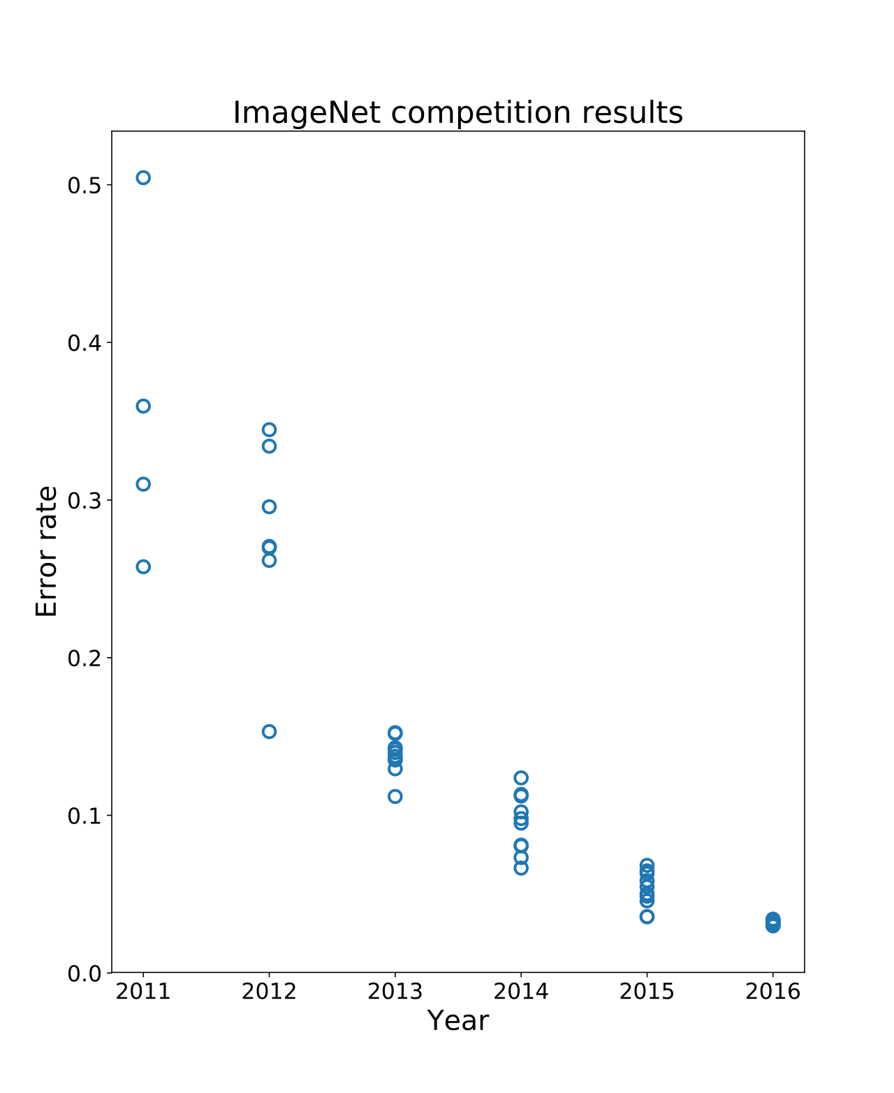
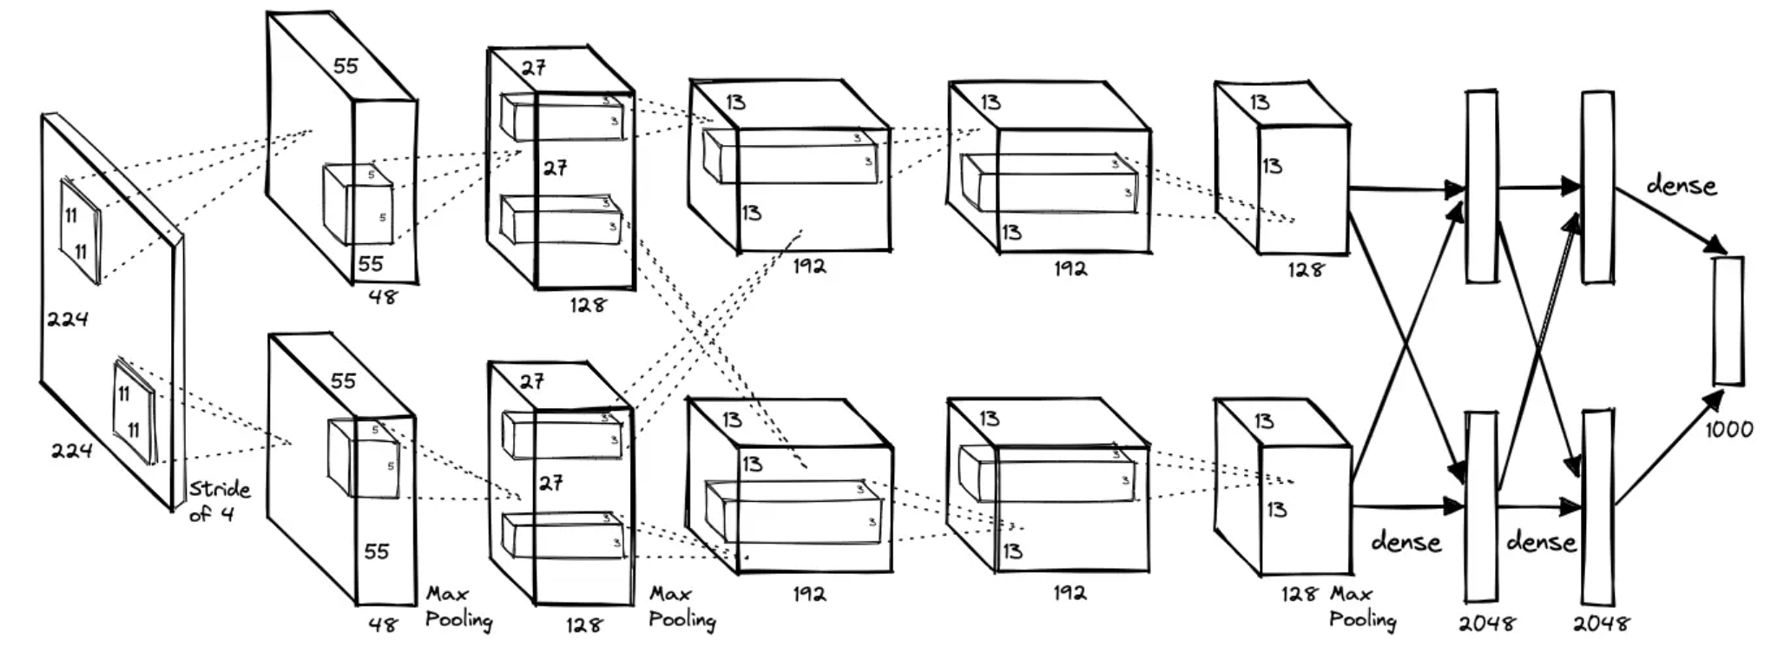
The important bits
AlexNet
Notes:
So how did this happen?
I want to just highlight two important events that happened last decade. The first is the imagenet competition…

Slide 13
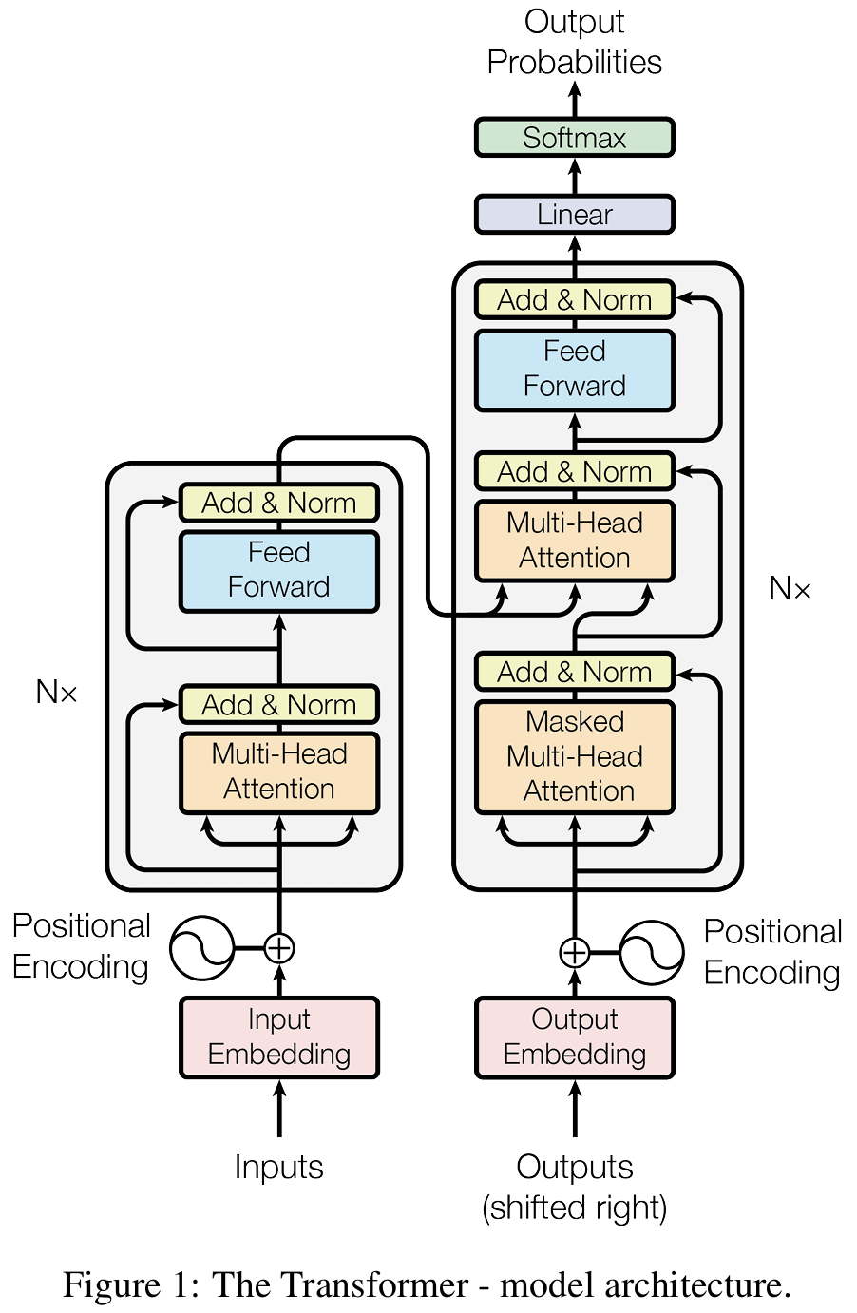
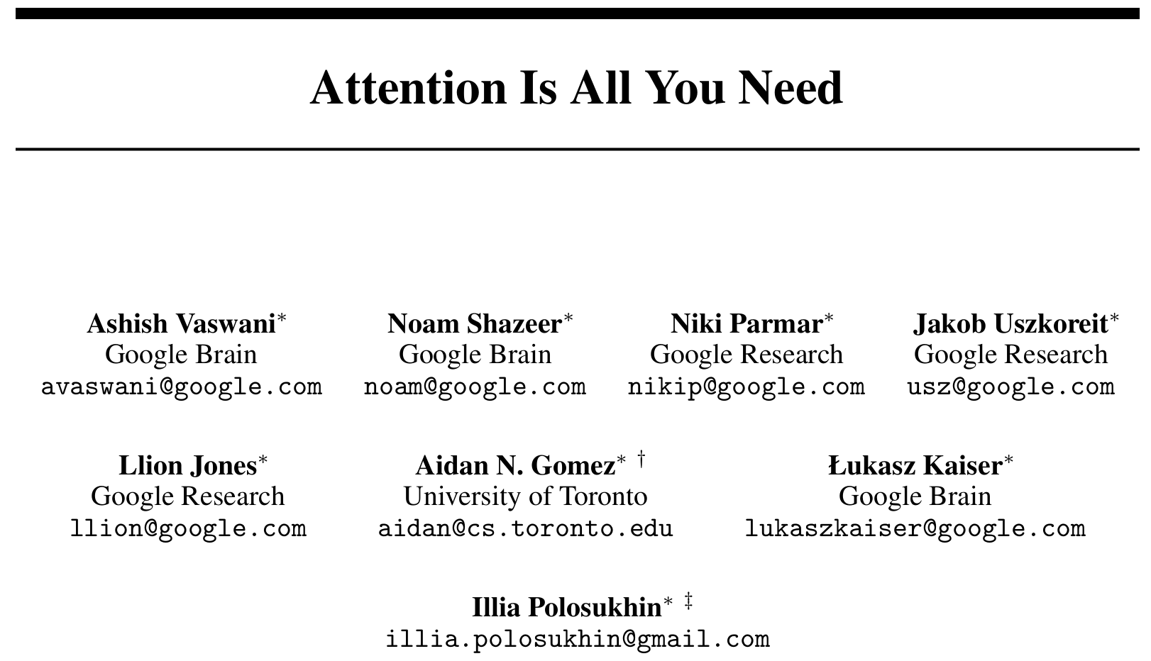
The important bits
Notes:
The second is attention.
This architecture is responsible for all of the AI we see today.

Slide 14
Some misunderstandings
Model | A parameterized function that maps input text sequences to output text distributions. It has billions of parameters that are optimized by minimizing a prediction loss function over a massive corpus of text. | ChatGPT Claude Gemini
Learning | Synonymous with training – the process where weights are systematically modified through algorithms like gradient descent to minimize some objective function. | Recognition of preferences, adaptation of the writing style, and recall of previous information.
Context | The input to the model. | Important information that might be necessary to perform a certain task.
Notes:
We use these words differently, depending on who we talk to…
…story about my mother-in-law…

Slide 15
LLMs
The greatest hits
Notes:
For the remainder of this session, we’re going to go on a whirlwind tour of LLMs

Slide 16
Before we begin…
What do YOU know about LLMs…?
How do they work?
Can you name any?
What can you use them for?
Can you see any problems with them?
Notes:
Take a few minutes to think about these questions

Slide 17
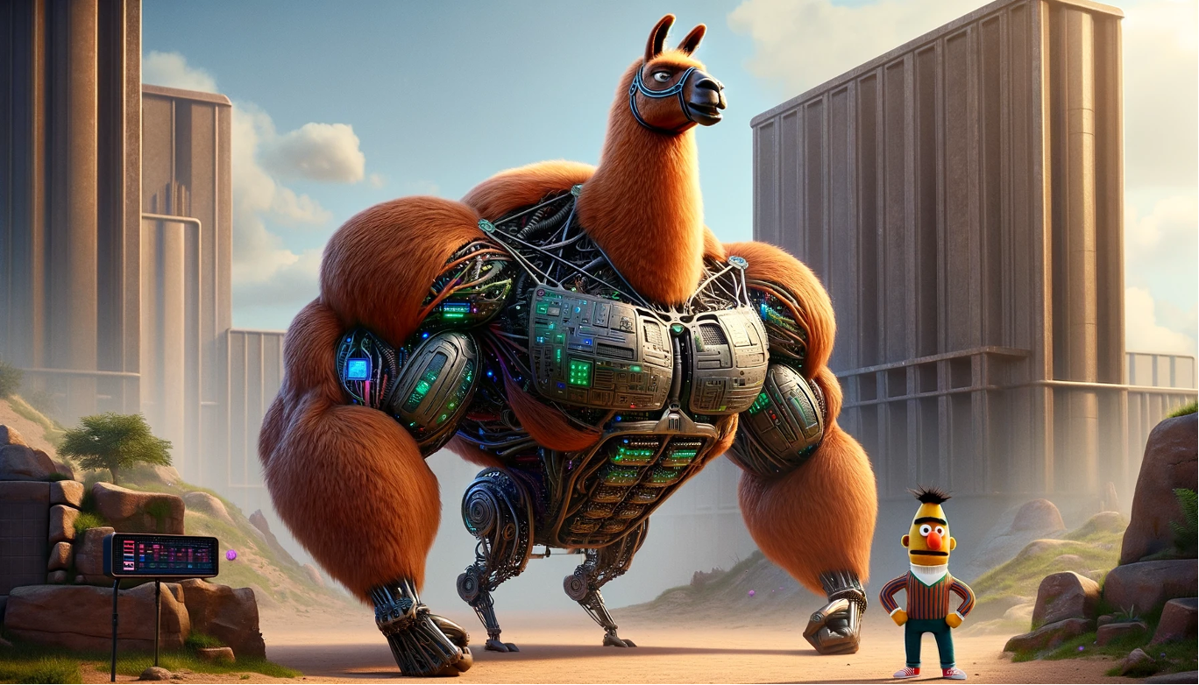
Who or what is BERT, and why is he/it useful?
Notes:
This image demonstrates two types of models:
On the left, you have the hulking beast of a Llama model - a massive 70b or 405b parameter model. This is like chatgpt
On the right, you have little old BERT.
These models are both transformers. They are both language models. And BERT would have been considered a “large” language model, when it was conceived in 2018, with 108M or 334M parameters, depending on the model. That means it takes up around 200-600MB in RAM.
BERT
BERT is a Bidirectional Encoder-only model. In the LLM space, you’ll have words thrown around like encoder, decoder, autoregressive model.
So what does BERT Do? And what makes it different from ChatGPT?

Slide 18
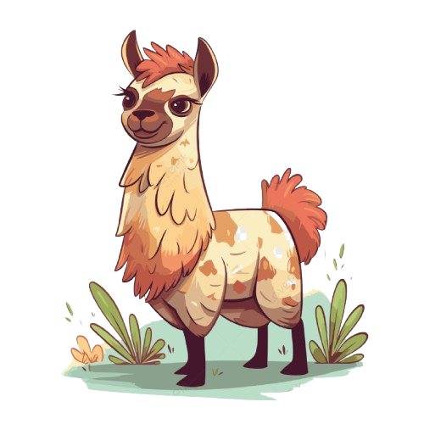
Llama
Large Language Model Meta AI
‘<bos>’’
‘the’
‘cat’
‘sat
‘on’
‘the’
‘mat’
‘<eos>’
101
1996
4937
6583
2006
1996
13523
102
‘the’
‘cat’
‘sat’
‘on’
‘the’
‘mat’
‘mat’ | 0.19
‘dog’ | 0.14
‘hippo’ | 0.07
‘was’ | 0.000001
Notes:
ChatGPT and other “generative” models, are next token predictors. In other words, given some input tokens for example, “The cat sat on the”, then what is the next token.

Slide 19

BERT
Bidirectional Encoder Representations from Transformers
‘[CLS]’
‘the’
‘cat’
‘[MASK]’
‘on’
‘the’
‘mat’
‘[SEP]’
101
1996
4937
103
2006
1996
13523
102
‘the’
‘cat’
‘sat’
‘on’
‘the’
‘mat’
‘sat’ | 0.19
‘was’ | 0.14
‘lay’ | 0.07
‘hippo’ | 0.000001
Notes:
BERT is what we call a masked token predictor. Here we have the same example. Except this time, we have masked the token “sat”. The job for bert is to predict this masked token. You see on the right, lots of different options. BERT will actually predict the probability of every possible token being the next token. So let’s say each token is a word, and suppose there are 200,000 words to choose from, then you’ll end up with 200,000 numbers. And the biggest number is the most likely next token. We’ll come back to this right hand side. But first I want to look at what’s going on in the left hand side.

Slide 20
Tokenization

Slide 21
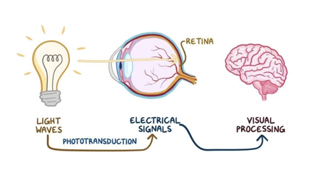
Tokenization
“the cat sat on the mat”
Notes:
Think of this phrase. What actually happens when you read this on the screen.
There is an equivalent process that happens when you hear it.

Slide 22
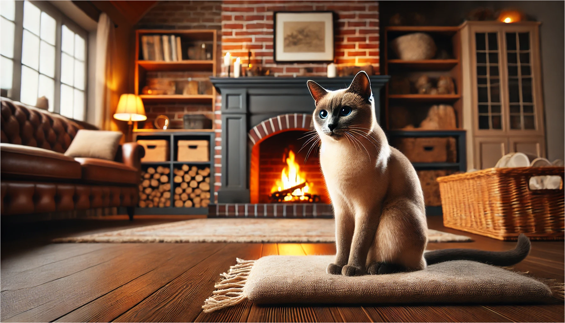

Slide 23
Tokenization
The machine starts from scratch…
text = "the cat sat on the mat"
tokens = ['the', 'cat', 'sat', 'on', 'the', 'mat']
map = {'cat': 0, 'mat': 1, 'on': 2, 'sat': 3, 'the': 4}
tokenized_text = [4, 0, 3, 2, 4, 1]
Notes:
So we need to convert these words to numbers.
Incidentally, there is an argument made that goes something like:
“An LLM is different from a human, because it can’t understand text, it can only understand numbers.”
And I think there is a strong conflation between what we consider as the model, and the model plus the infrastructure that exists to support the model. Which is going to come up again.
Because if we think about what we encountered when looked at human preprocessing, our “model” doesn’t work with words either, it works with electrical signals - there is a bunch of preprocessing that has to happen before the concept of a cat sitting on a mat becomes available to conscious attention.
Anyway, here we have used an example sentence.

Slide 24
Tokenization
We could tokenize by character instead of by word…
text = "the cat sat on the mat"
tokens = ['t', 'h', 'e', ' ', 'c', 'a', 't', ' ', 's', 'a', 't', ' ', 'o', 'n', ' ', 't', 'h', 'e', ' ', 'm', 'a', 't']
…maybe not…

Slide 25
Tokenization
We use BPE tokenization
…instead of whole words or individual characters, we look at subwords…

Slide 26
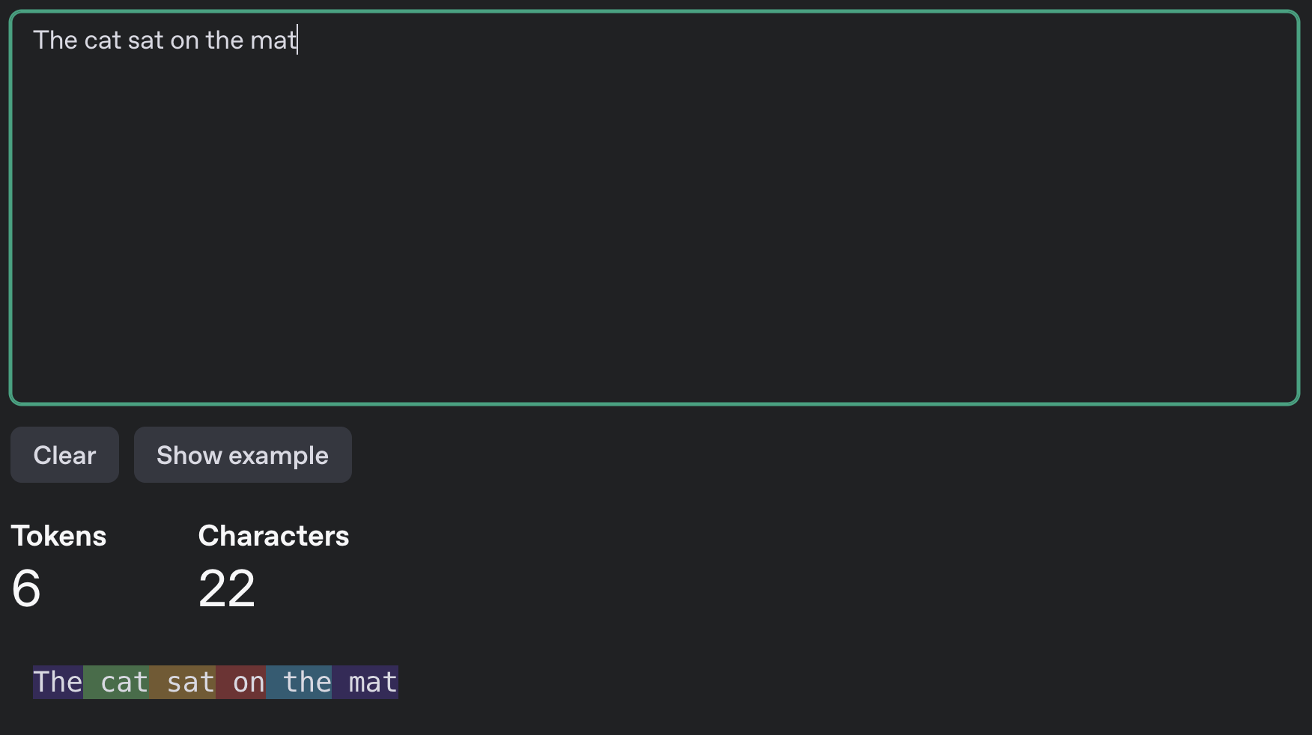

Slide 27
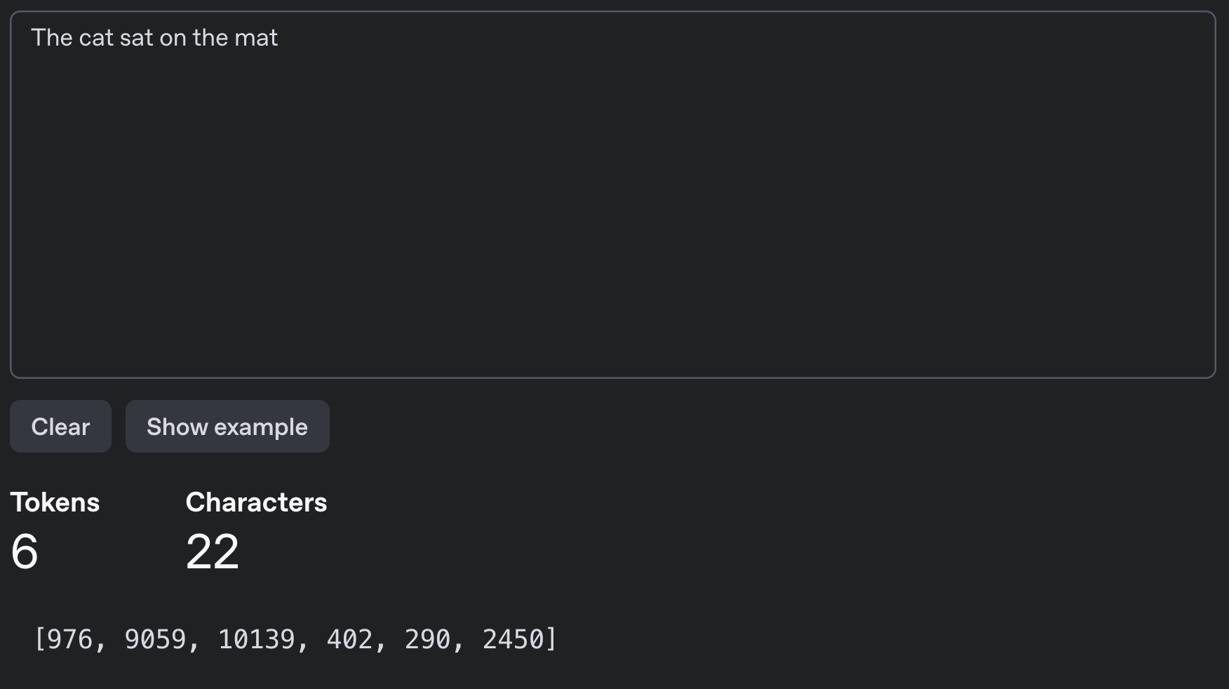

Slide 28
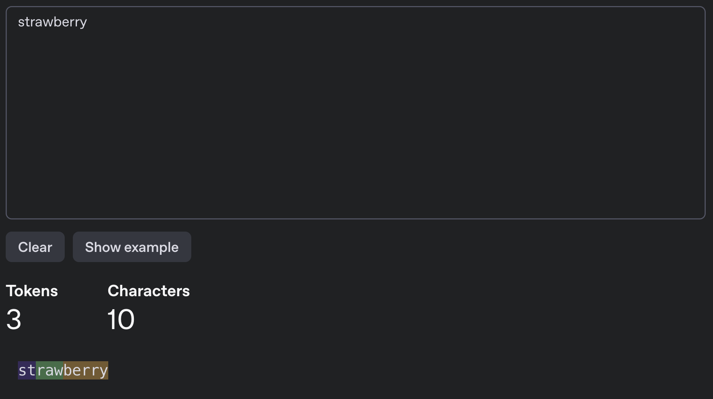
Notes:
Why LLMs can’t tell you how many letters in a word

Slide 29
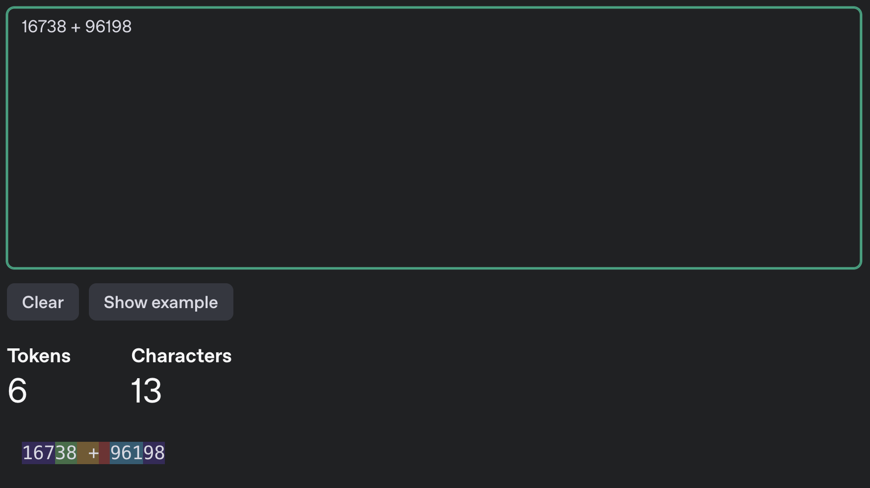
Notes:
Why they are bad at maths

Slide 30
Tokenization
The most popular tokenizer is called tiktoken
Its vocabulary contains ~100k tokens
The tokenizer is “trained” on a massive text corpus
The tokenizer is trained separately from the model
Notes:
So in the previous example, we used a single sentence. In reality you use TB of data.
40TB in fact.

Slide 31
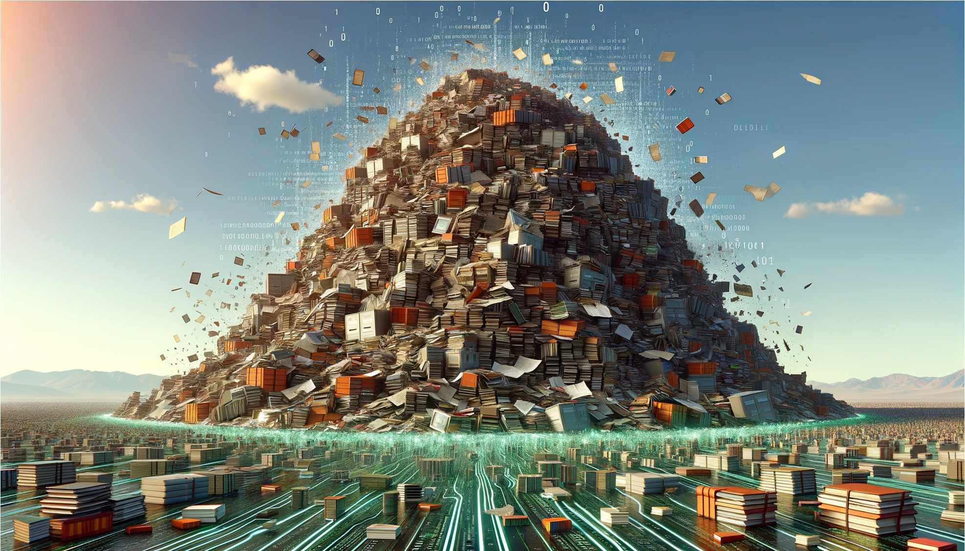
Notes:
The Pile, a nearlyt 900GB text database.
- Common Crawl (46% is English, and every other language is below 6%). It includes copyrited materials
- Stack exchange,
- ArXiv
- GitHub
- PubMed
- Wikipedia
- YouTube subtitles and comments
- Reddit
If anyone has frequented the YouTube comment section at any point or reddit in general, you can see how problematic this might be. If anyone interacted with the earlier versions of GPT-3, it was really quite unconstrained. (back in September 2021)
For Llama-2 this required 6,000 A100s for 12 days, which would have cost about $2M (not including the cost of the A100s, which are about 15-20k USD apiece…).
But this is only a small part of the dataset. Llama 3 was trained on 44TB of text or 15 trillion tokens and what we’ve got out of it, is for a 70B parameter model, which is about 140GB. So you can think of an LLM as a compression of the information that it was trained on, and in fact there is a correspondence between good compression and a good predictor.

Slide 32
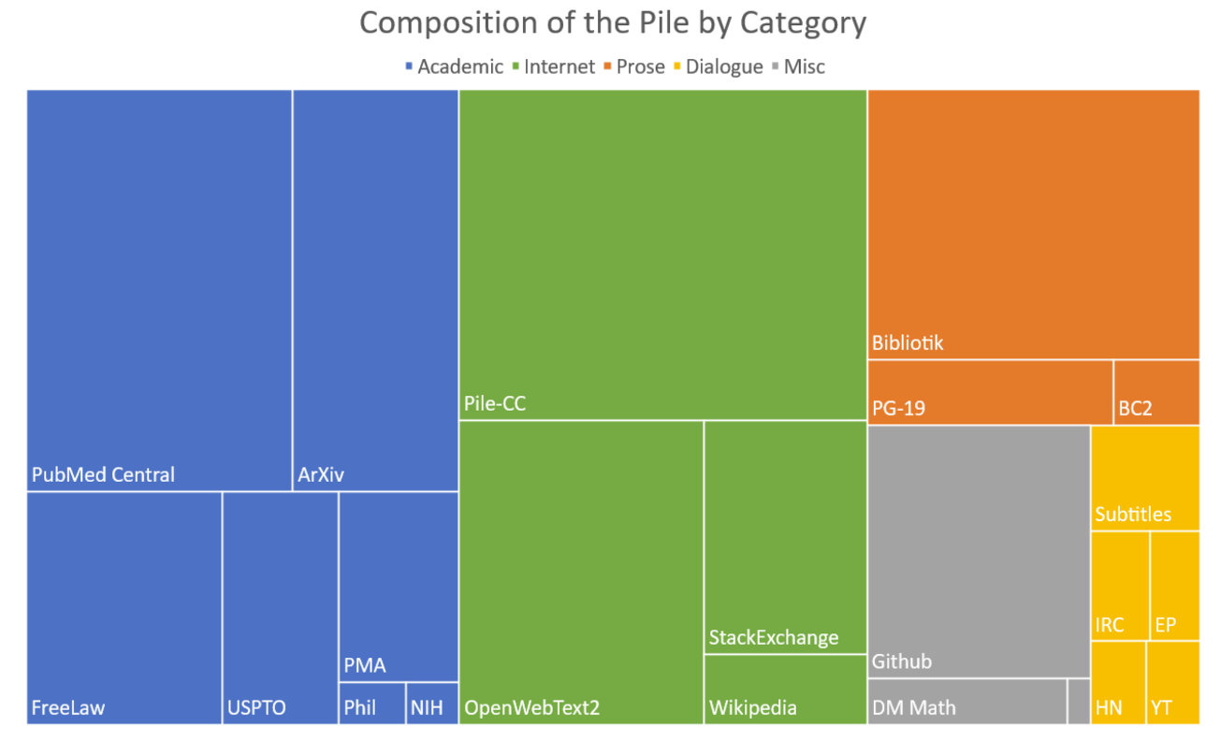
Training data
~200k books
~27B tokens
~110GB
Llama 3
~15T tokens
~44TB
< 0.2%!!
Notes:
A good way to understand the scale of the training data is to consider the Bibliotik dataset. It is nearly 200k books. Think about how many books you’ve read in your life, and how long it would take to read 200k books. If you read one book per month, you would still read under 1000 books in your entire life. This dataset is about 100GiB and around 11% of The Pile. The pile is is around 900GiB. The size of the training data for Llama 3 was 44TB of text. So 200k books is only 0.2% of the total training data used on Llama 3.

Slide 33
BERT
Bidirectional Encoder Representations from Transformers
‘[CLS]’
‘the’
‘cat’
‘[MASK]’
‘on’
‘the’
‘mat’
‘[SEP]’
101
1996
4937
103
2006
1996
13523
102
‘the’
‘cat’
‘sat’
‘on’
‘the’
‘mat’
‘sat’ | 0.19
‘was’ | 0.14
‘lay’ | 0.07
‘hippo’ | 0.000001
Notes:
OK, so the that’s what is happening on the left hand side.

Slide 34
BERT
Bidirectional Encoder Representations from Transformers
‘[CLS]’
‘the’
‘cat’
‘[MASK]’
‘on’
‘the’
‘mat’
‘[SEP]’
101
1996
4937
103
2006
1996
13523
102
‘the’
‘cat’
‘sat’
‘on’
‘the’
‘mat’
‘sat’ | 0.19
‘was’ | 0.14
‘lay’ | 0.07
‘hippo’ | 0.000001
Notes:
And finally, what is happening on the output?

Slide 35
768
101
1996
4937
103
2006
1996
13523
102
0.19 | ‘sat’
0.14 | ‘was’
0.07 | ‘lay’
w_{1,1} | w_{1,2}
w_{2,1} | w_{2,2}
w_{3,1} | w_{3,2}
w_{4,1} | w_{4,2}
w_{5,1} | w_{5,2}
w_{6,1} | w_{6,2}
w_{7,1} | w_{7,2}
w_{8,1} | w_{8,2}
w_{1,768}
w_{2,768}
w_{3,768}
w_{4,768}
w_{5,768}
w_{6,768}
w_{7,768}
w_{8,768}
0.167 | 0.896 |  | 0.671
0.108 | -0.111 |  | 0.002
8
50k
0.011 | 0.991 |  | 0.023
0.01 | ‘dog’
Notes:
This looks complicated, but it’s actually really simple.

Slide 36
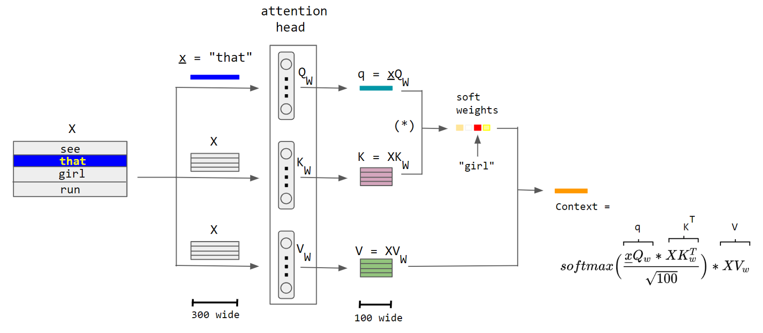
It’s a little more complicated…
Notes:
OK, so maybe it’s not QUITE that simple…
Brief overview of the query, key and value vectors

Slide 37
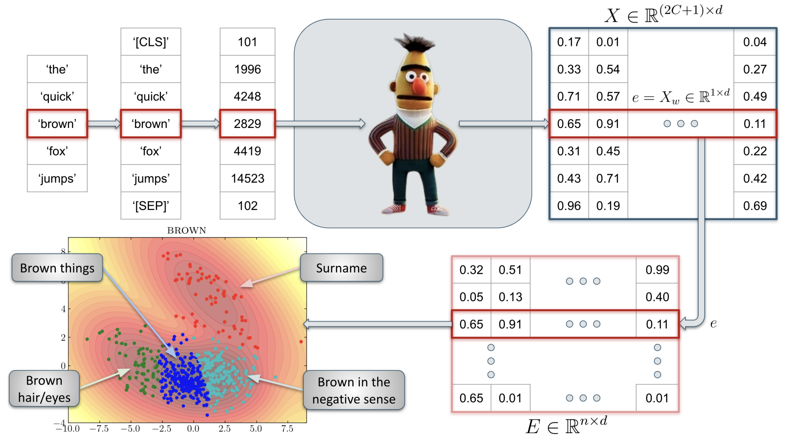
Notes:
So that brings us to this project. In this example, we might be interested in the word brown

Slide 38
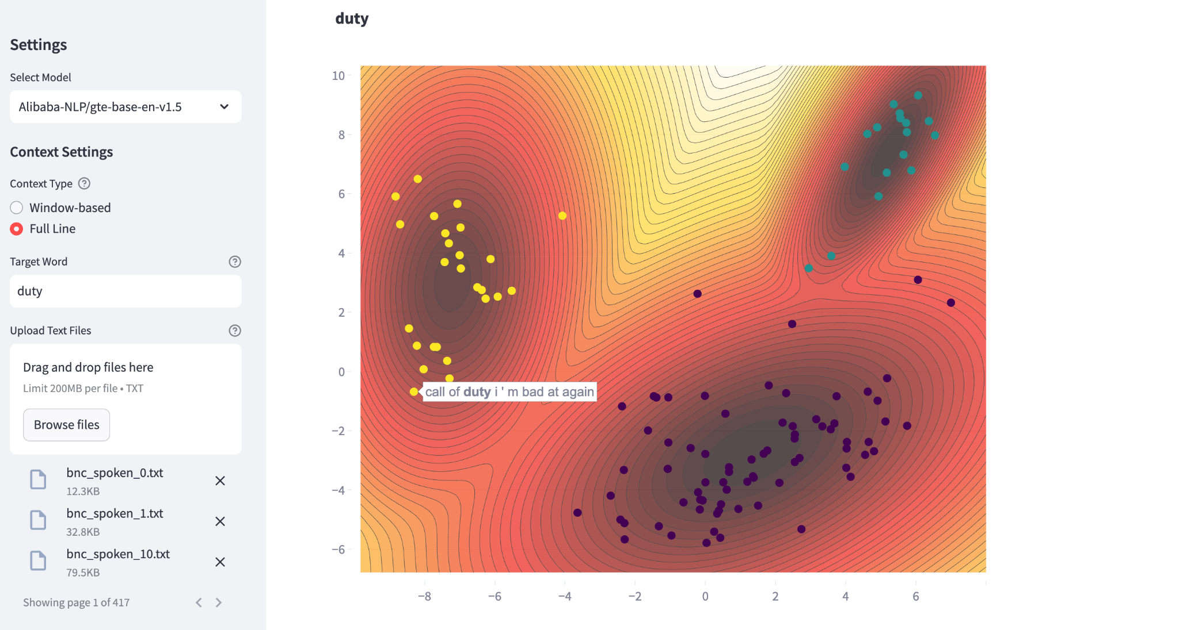
Notes:
Nice little call of duty cluster

Slide 39
What about ChatGPT
Not everything is what it seems…

Slide 40
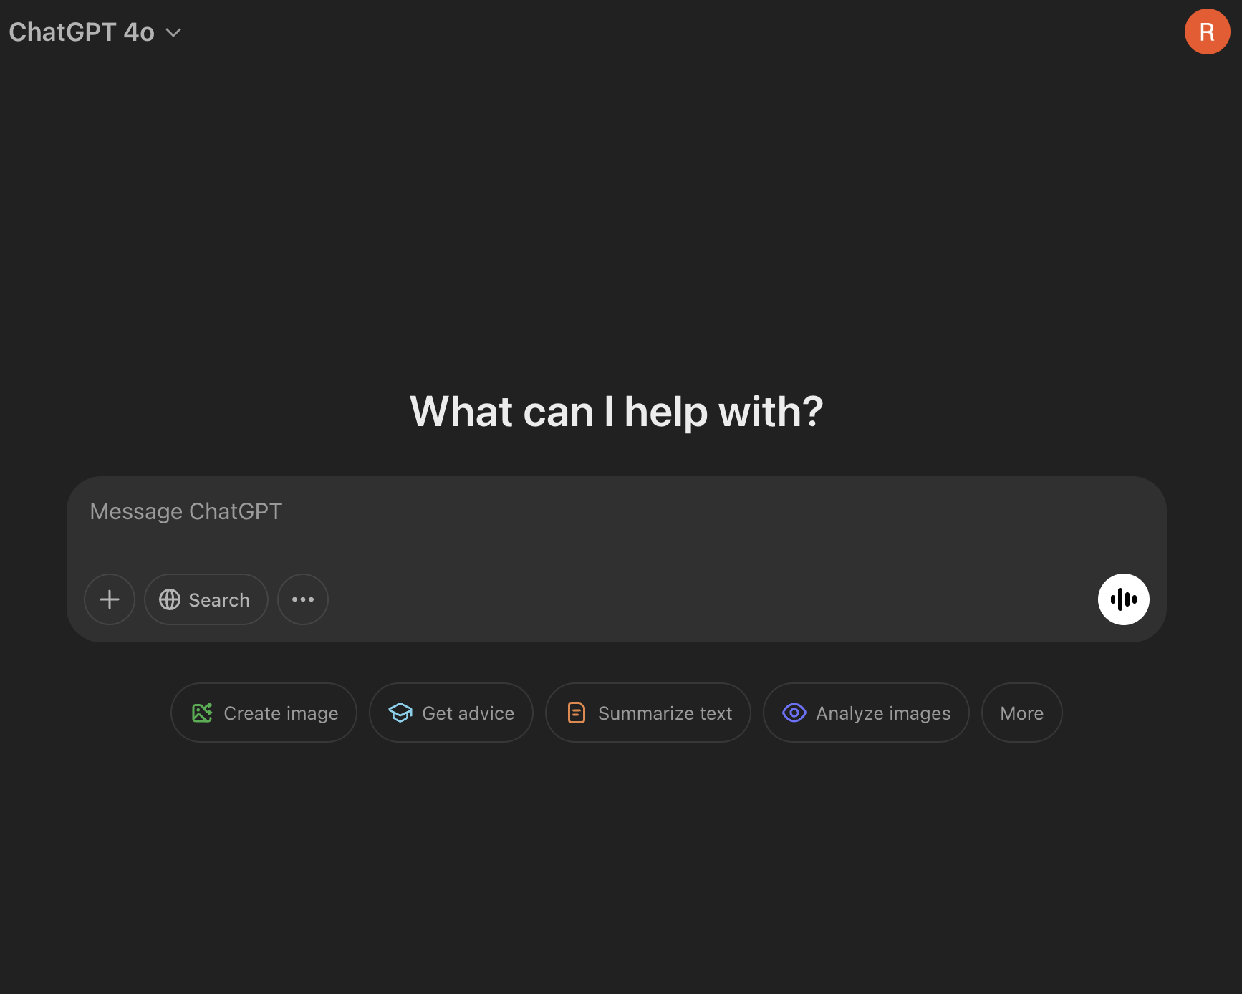
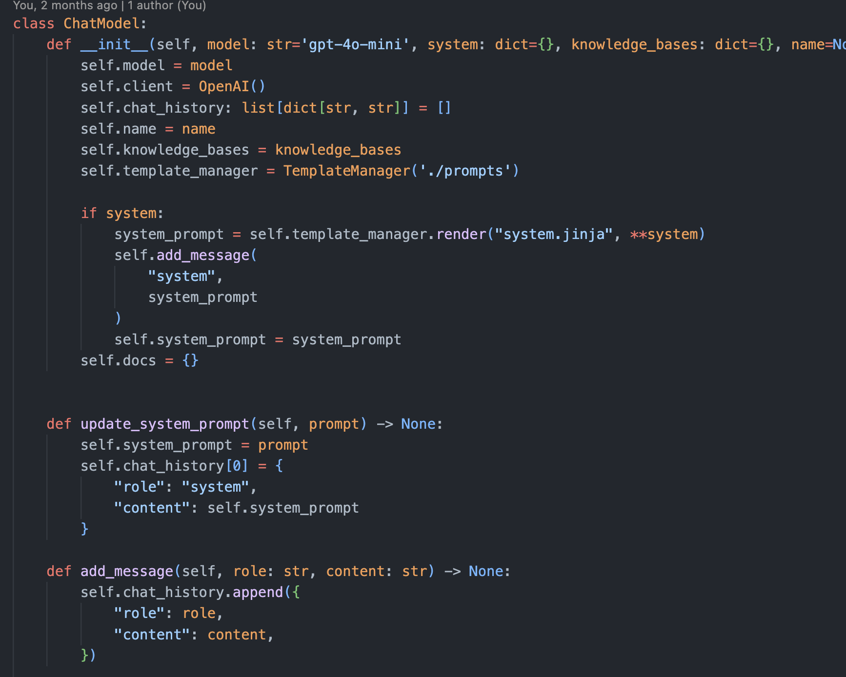
Interacting with GPT Models
Notes:
This is what we see when we interact with LLMs, a nice window, showing a great user experience.
In reality of course, there is a bunch of code underneath it all.

Slide 41
LLMs are stateless!
‘<bos>’’
‘the’
‘cat’
‘sat
‘on’
‘the’
‘mat’
‘<eos>’
101
1996
4937
6583
2006
1996
13523
102
‘the’
‘cat’
‘sat’
‘on’
‘the’
‘mat’
‘mat’ | 0.19
‘dog’ | 0.14
‘hippo’ | 0.07
‘was’ | 0.000001

Slide 42
LLMs are Stateless!
Chat history
Chat history
Query
Query
Response
Query
Response
Response
Notes:
This is us on the left, looking at our browser window

Slide 43
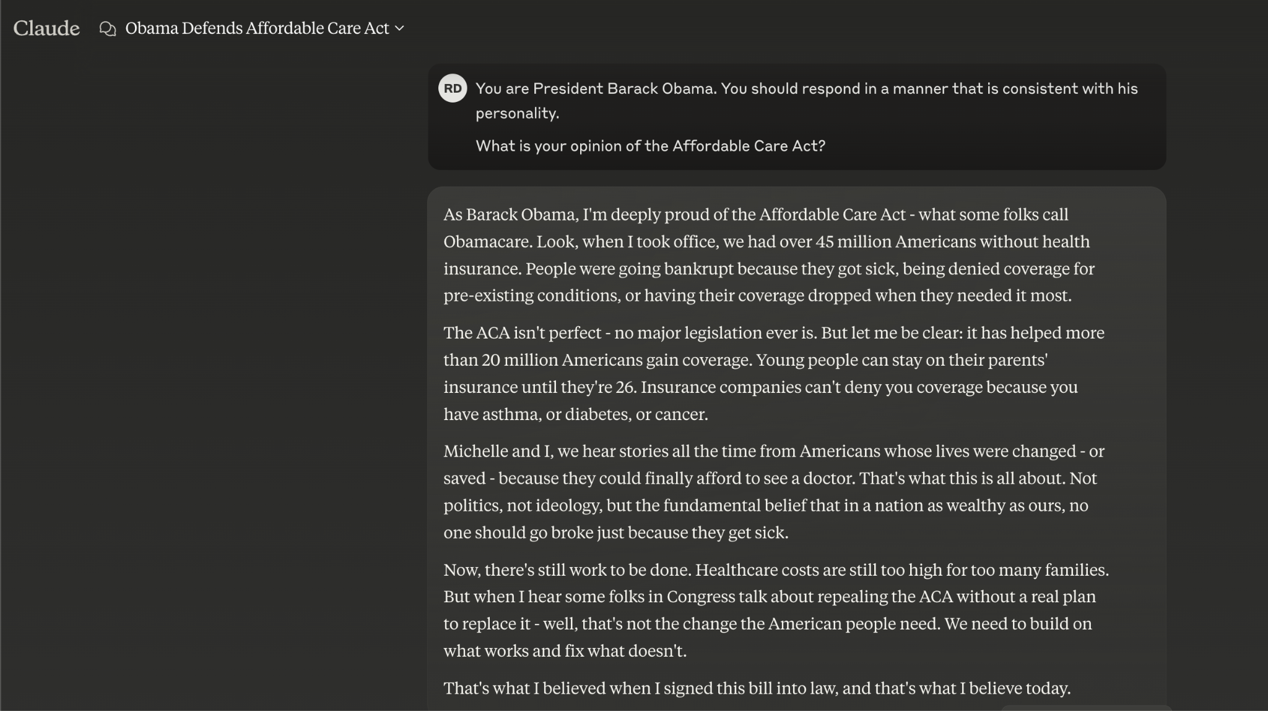

Slide 44
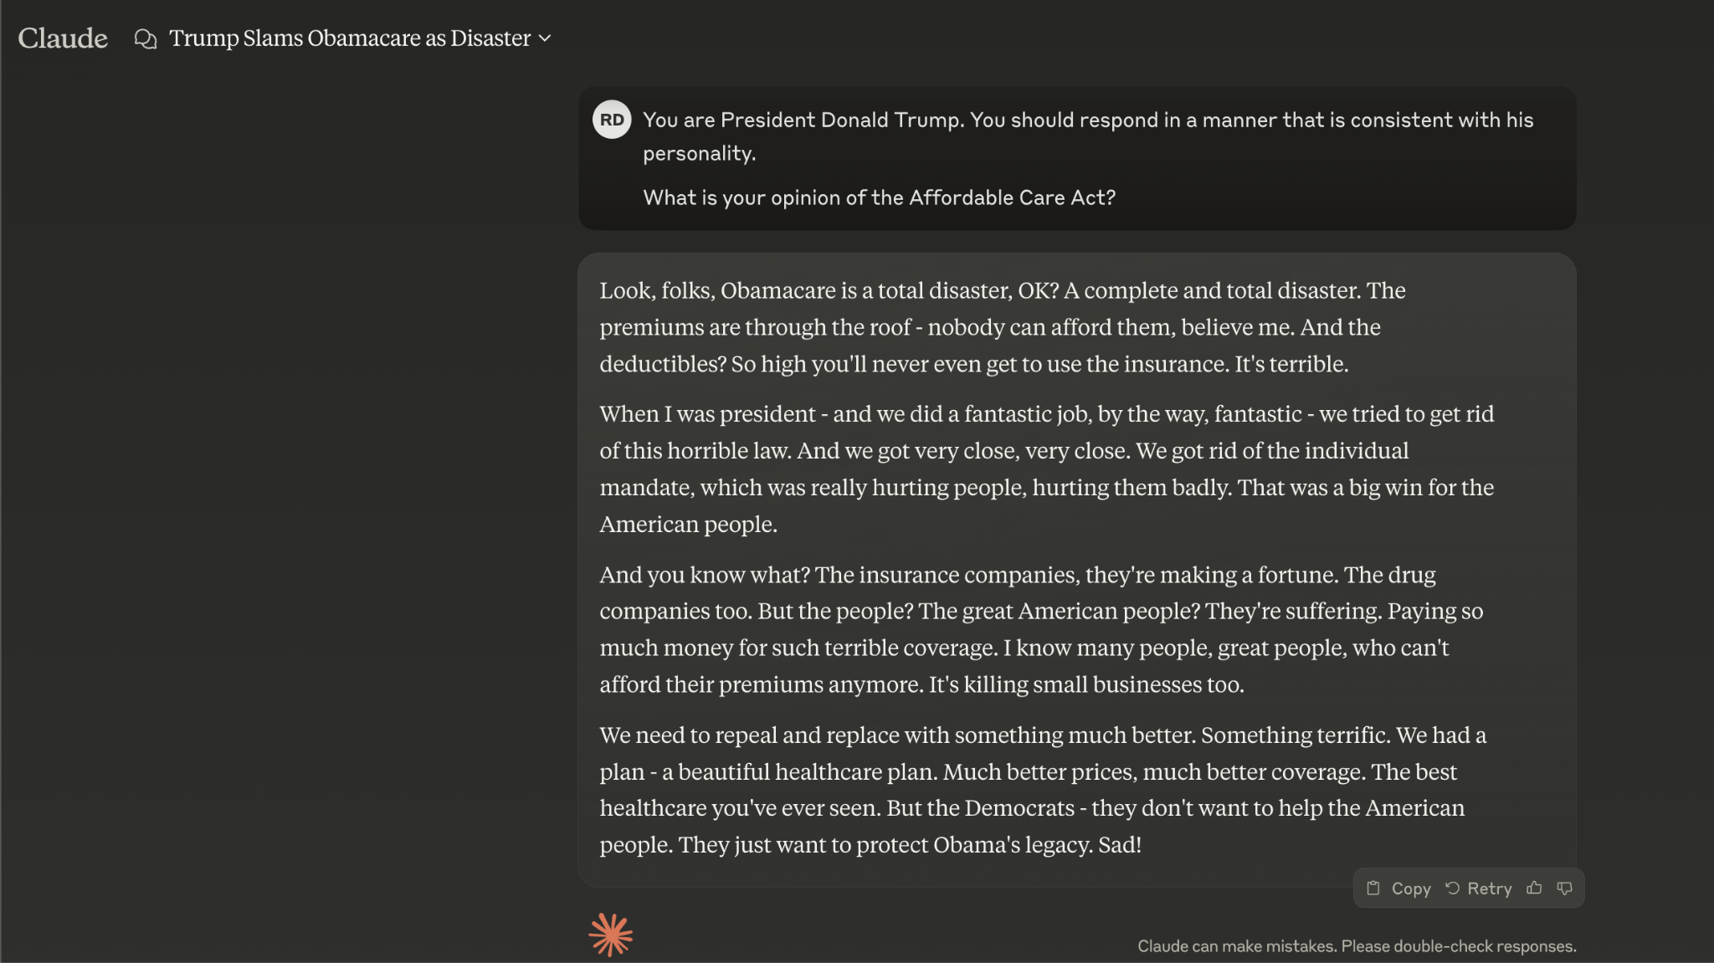
Notes:
We can ask a model to take on a persona, and have it speak and “think” like the real person.

Slide 45
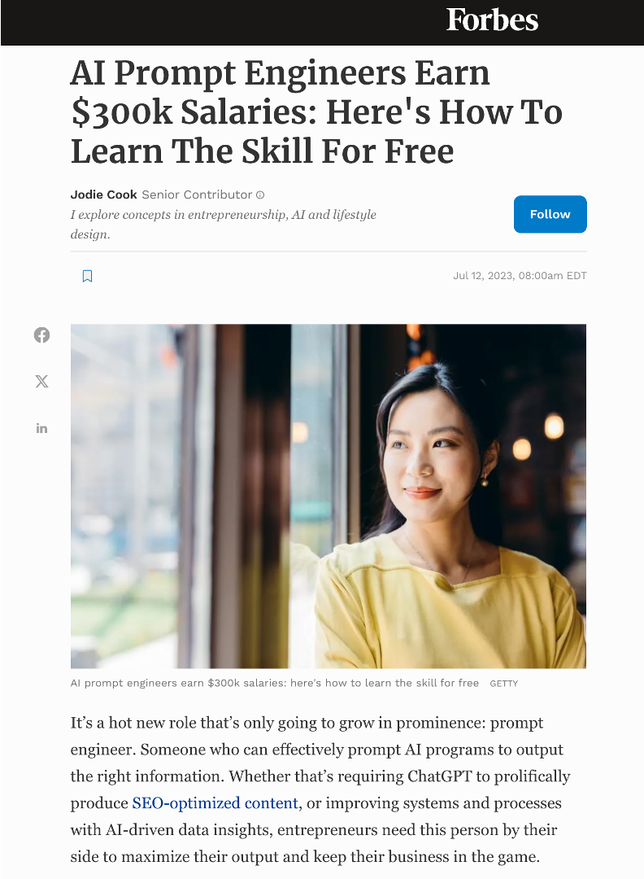
Prompt Engineering
System prompt
User prompt
In context learning

Slide 46
Prompt engineering
LLMs have distinct input and output patterns
‘system’ : “You are Captain Jack Sparrow.”
‘user’ : “Provide me a recipe for macarons.”
‘assistant’ : “Aye matey, let me lay it on ya …”
Almost all LLMs will follow the same pattern

Slide 47
Prompt engineering
<|begin_of_text|><|start_header_id|>system<|end_header_id|>
You are Captain Jack Sparrow.<|eot_id|><|start_header_id|>user<|end_header_id|>
Provide me a recipe for macarons.<|eot_id|><|start_header_id|>assistant<|end_header_id|>
Aye matey, let me lay it on ya …<|eot_id|>
Notes:
This is what actually gets passed into the model.

Slide 48
Prompt engineering
LLMs have distinct input and output patterns
‘system’ : “You are Captain Jack Sparrow.”
‘user’ : “Provide me a recipe for macarons.”
‘assistant’ : “Aye matey, let me lay it on ya …”
Right…but how do I know it’s true…?
Notes:
This version is a bit more human readable!
The LLM here is still susceptible to hallucination - this is where the model just starts making stuff up. So we need a way to sort of ground the model in truth in some way.
And there are two issues here: how do we know the model is a true likeness of captain Jack, and how do we know the recipe is real?

Slide 49
In context learning
“Show, don’t tell”
‘system’ : “You are an expert in baking.”
‘info’ : [recipe 1, recipe 2, recipe 3, …, recipe N]
‘user’ : “Provide me a recipe for macarons.”
‘assistant’ : “Certainly! Here is a recipe for macarons …”
Notes:
Let’s address the recipe issue first…
What we do here, is we provide the LLM with a whole bunch of recipes, we might have 1000 for example. And we just copy and paste our entire recipe book, and we dump it into the ChatGPT window. We then ask it the question, and it’s up to the model to figure things out.
But what happens when our recipe book gets really big?

Slide 50
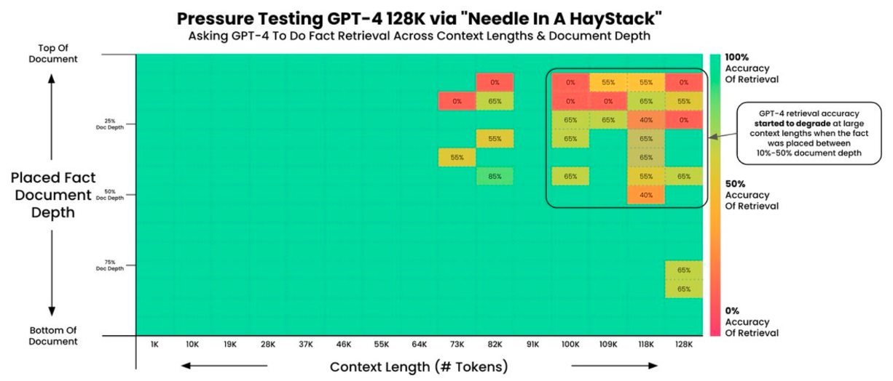
In context learning
Notes:
Harry Potter cell phone sentence example

Slide 51
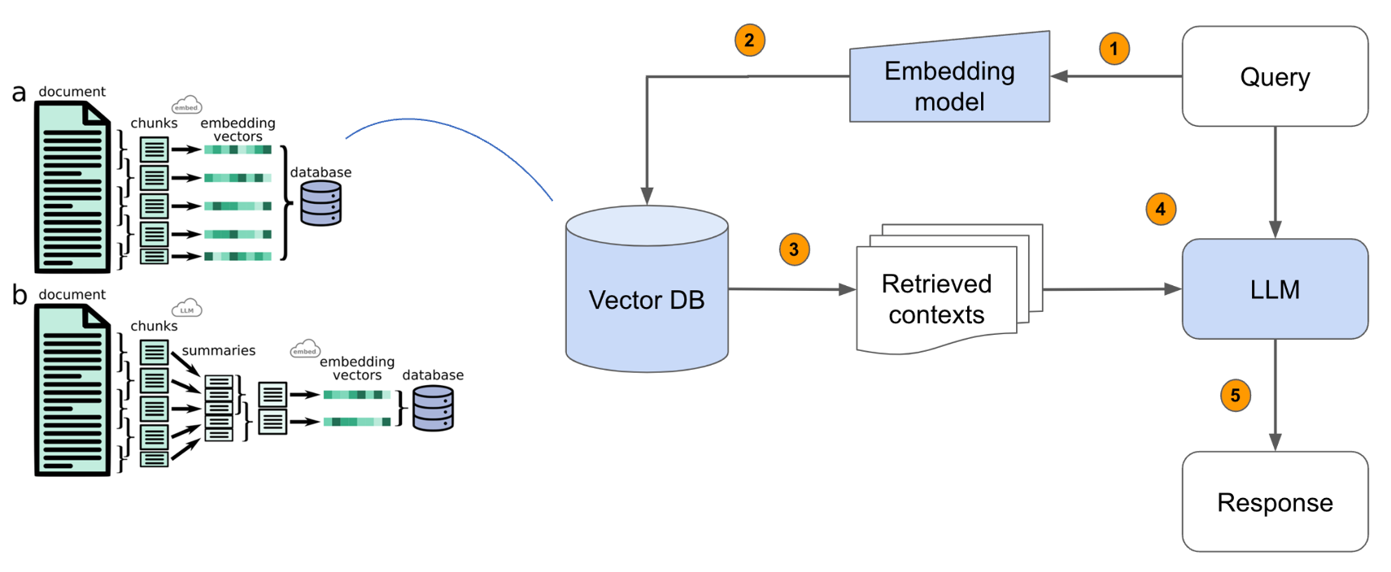
Retrieval Augmented Generation
Recipe book
Notes:
At the core of this idea is Retrieval Augmented Generation - also known as RAG.
Break into pieces, and search like google for the best recipe.

Slide 52
What about captain jack…?
This is where fine tuning comes into play…
We can actually take this big model and give it examples of Jack’s speech from the movie…
Notes:
But really the speaking style is not at all like obama or trump or captain jack. So can we try to get the model to emulate style?

Slide 53
What about captain jack…?
[
{
‘user’ : ‘It's a shilling for the dock space, and you're going to have to give me your name.’,
‘assistant’ : ‘What do you say to three shillings, and we forget the name?’
},
{
‘user’ : ‘What's your business in Port Royal, 'Mr. Smith'? And no lies!’,
‘assistant’ : ‘None? Very well. You've rumbled me. I confess: I intend to commandeer one of these ships, pick up a crew in Tortuga, and go out on the account, do a little honest pirating.’
},
]
Notes:
We feed these examples into the model. The goal is to have the model itself produce the content in the ‘assistant’ box.

Slide 54
Now what?

Slide 55
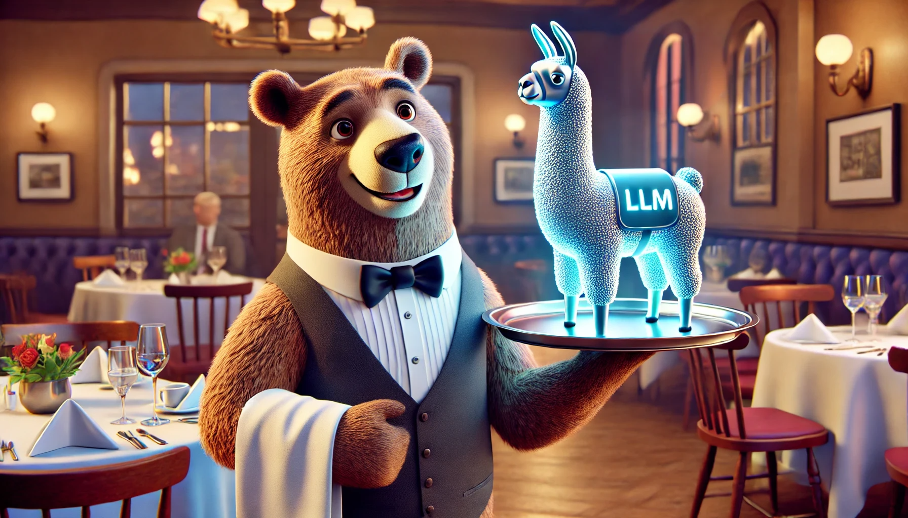
Notes:
So now we’re going to try some things for ourselves
(“serving” llama)

